Slide 1
How PHE1 and HDGs protein act on genes in Arabidopsis seeds?
Wenye
AG Köhler
29/05/2024

Slide 2
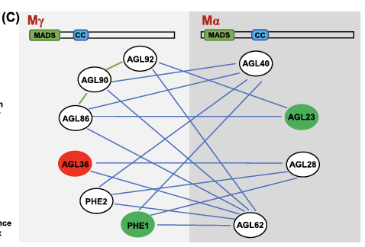
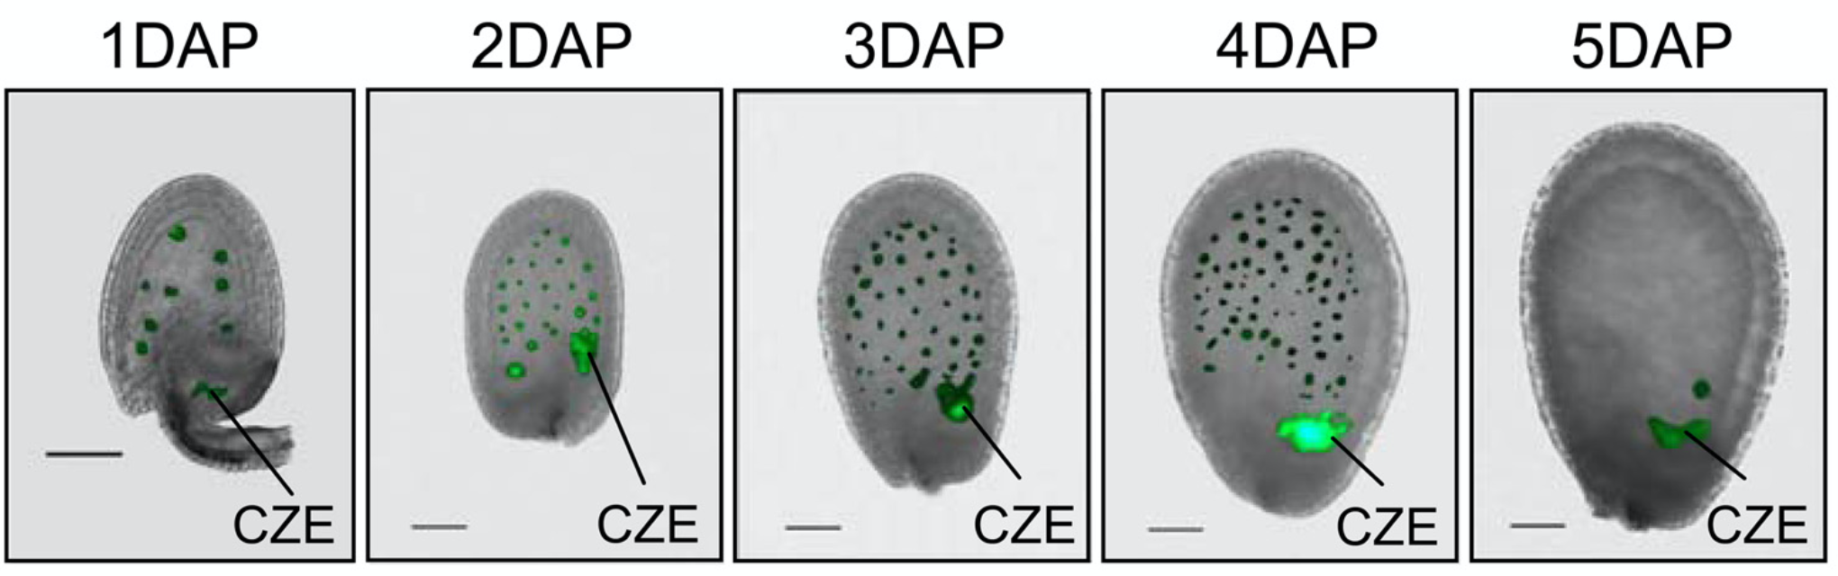
PHERES1
Type I MADS-box transcription factor
Paternally expressed imprinted gene – (PEG)
Targets many imprinted genes
pPHE1:PHE1-GFP
Interaction between MADS-α* and MADS-γ by Y2H

Slide 3
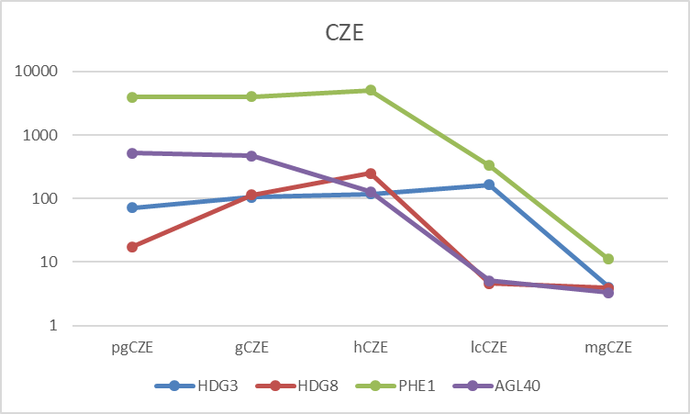
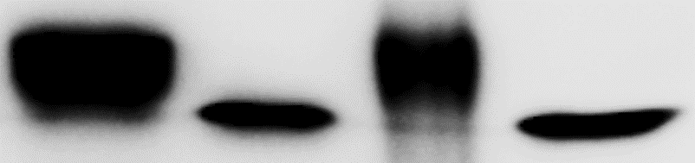
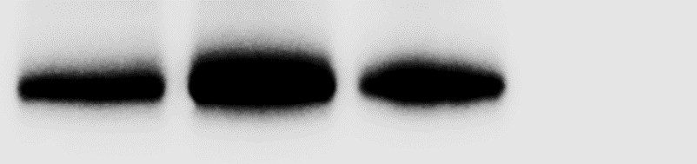

PHE1 interacts with AGL40 and Homeodomain proteins by IP-MS
Protein | Unique Peptides | Descriptions
AGL40 | 12 | MADS-box protein
PHE1 | 23 | MADS-box transcription factor PHERES1
HDG8 | 29 | Homeobox-leucine zipper protein HDG8
HDG3 | 17 | Homeobox-leucine zipper protein HDG3
Endosperm-specific
Input
Anti-Myc IP
Input
Anti-Myc IP
RMA normalized signals /Log10
Myc-PHE1
+HA-HDG3
Myc-Renilla
+HA-HDG3
Myc-PHE1
+HA-HDG3
Myc-Renilla
+HA-HDG3
Myc-PHE1
+HA-HDG8
Myc-Renilla
+HA-HDG8
Myc-PHE1
+HA-HDG8
Myc-Renilla
+HA-HDG8
Anti-Myc
CZE: chalazal endosperm
Based on Belmonte et al., 2013 data
Anti-HA
PHE1 and HDG3
PHE1 and HDG8

Slide 4
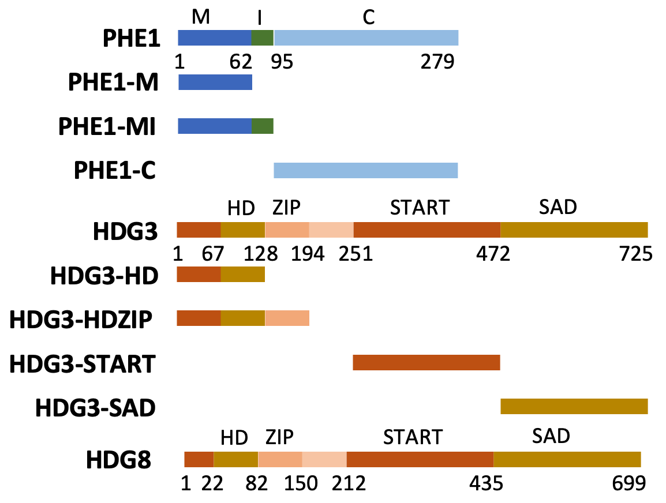
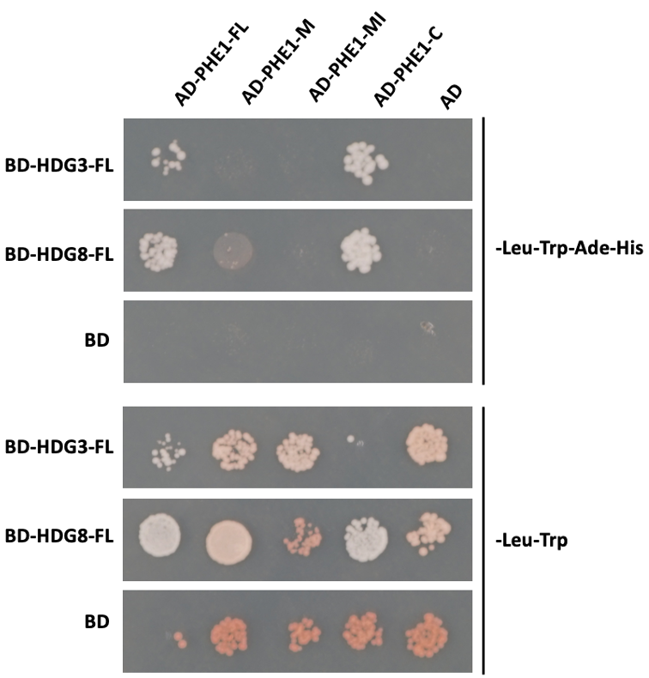
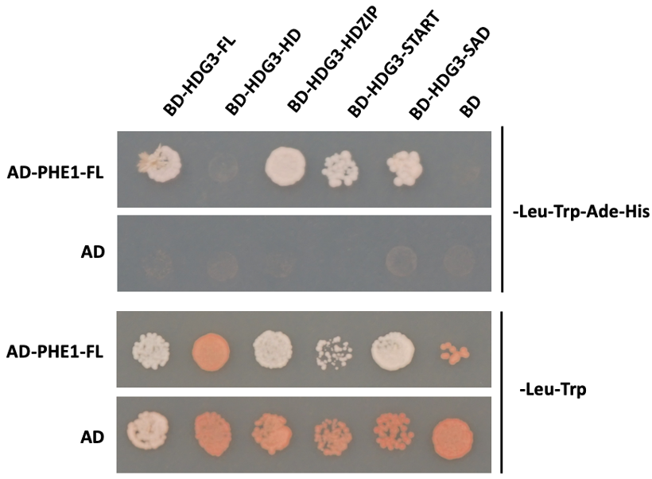
PHE1 interact with HDG3/8 by Y2H
HD: homoedomain, DNA binding domain
ZIP: Leucine zipper, DNA binding domain
START: nuclear transport, regulate the dimerization
SAD: Start-adjacent domain
PHE1 C- terminal domain mediate the interaction with HDG3 and HDG8.
All domains of HDG3 interact with PHE1, except the DNA binding homeobox domain.

Slide 5
HDGs don‘t interact with AGL40
Homo- Hetero-dimer formation between HDGs.
AD-HDG3-FL
AD
AD-AGL23-FL
AD
AD-HDG8-FL
AD-AGL28-FL
AD-AGL40-FL
AD-AGL62-FL
BD-HDG3-FL
BD-HDG3-FL
BD-HDG8-FL
-Leu-Trp-Ade-His
BD-HDG8-FL
-Leu-Trp-Ade-His
BD
BD
BD-HDG3-FL
BD-HDG3-FL
-Leu-Trp
BD-HDG8-FL
BD-HDG8-FL
-Leu-Trp
BD
BD

Slide 6
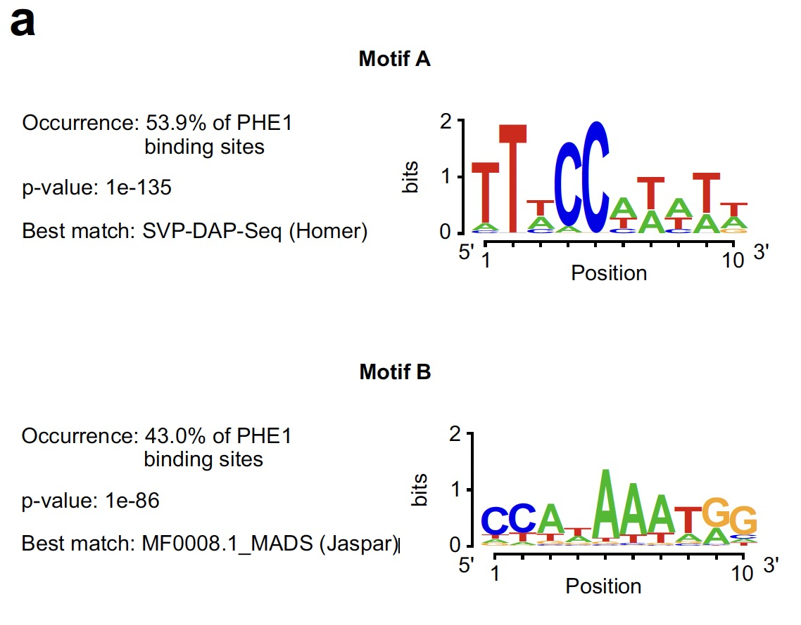

MADS and HDG motifs co-occur in PHE1 binding sites
MADS-
MADS-
Batista et al., eLIFE 2019
HDG motif1
Occurrence: 37.39%
p-value: 1e-9
Best match: HDG1 (Homeobox)

Slide 7
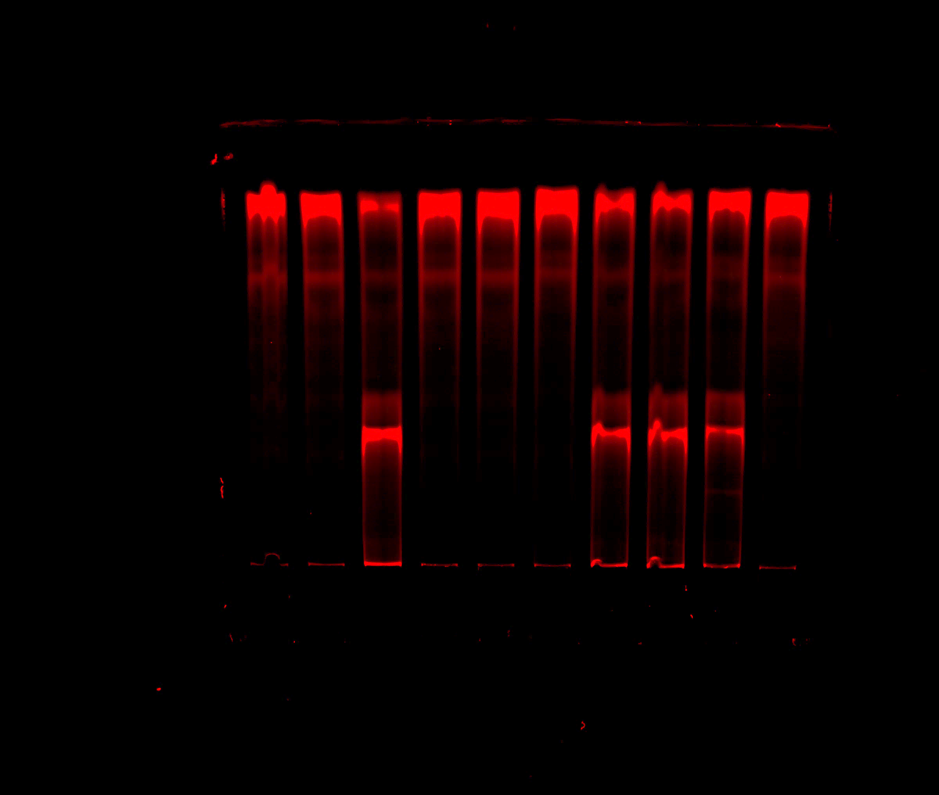
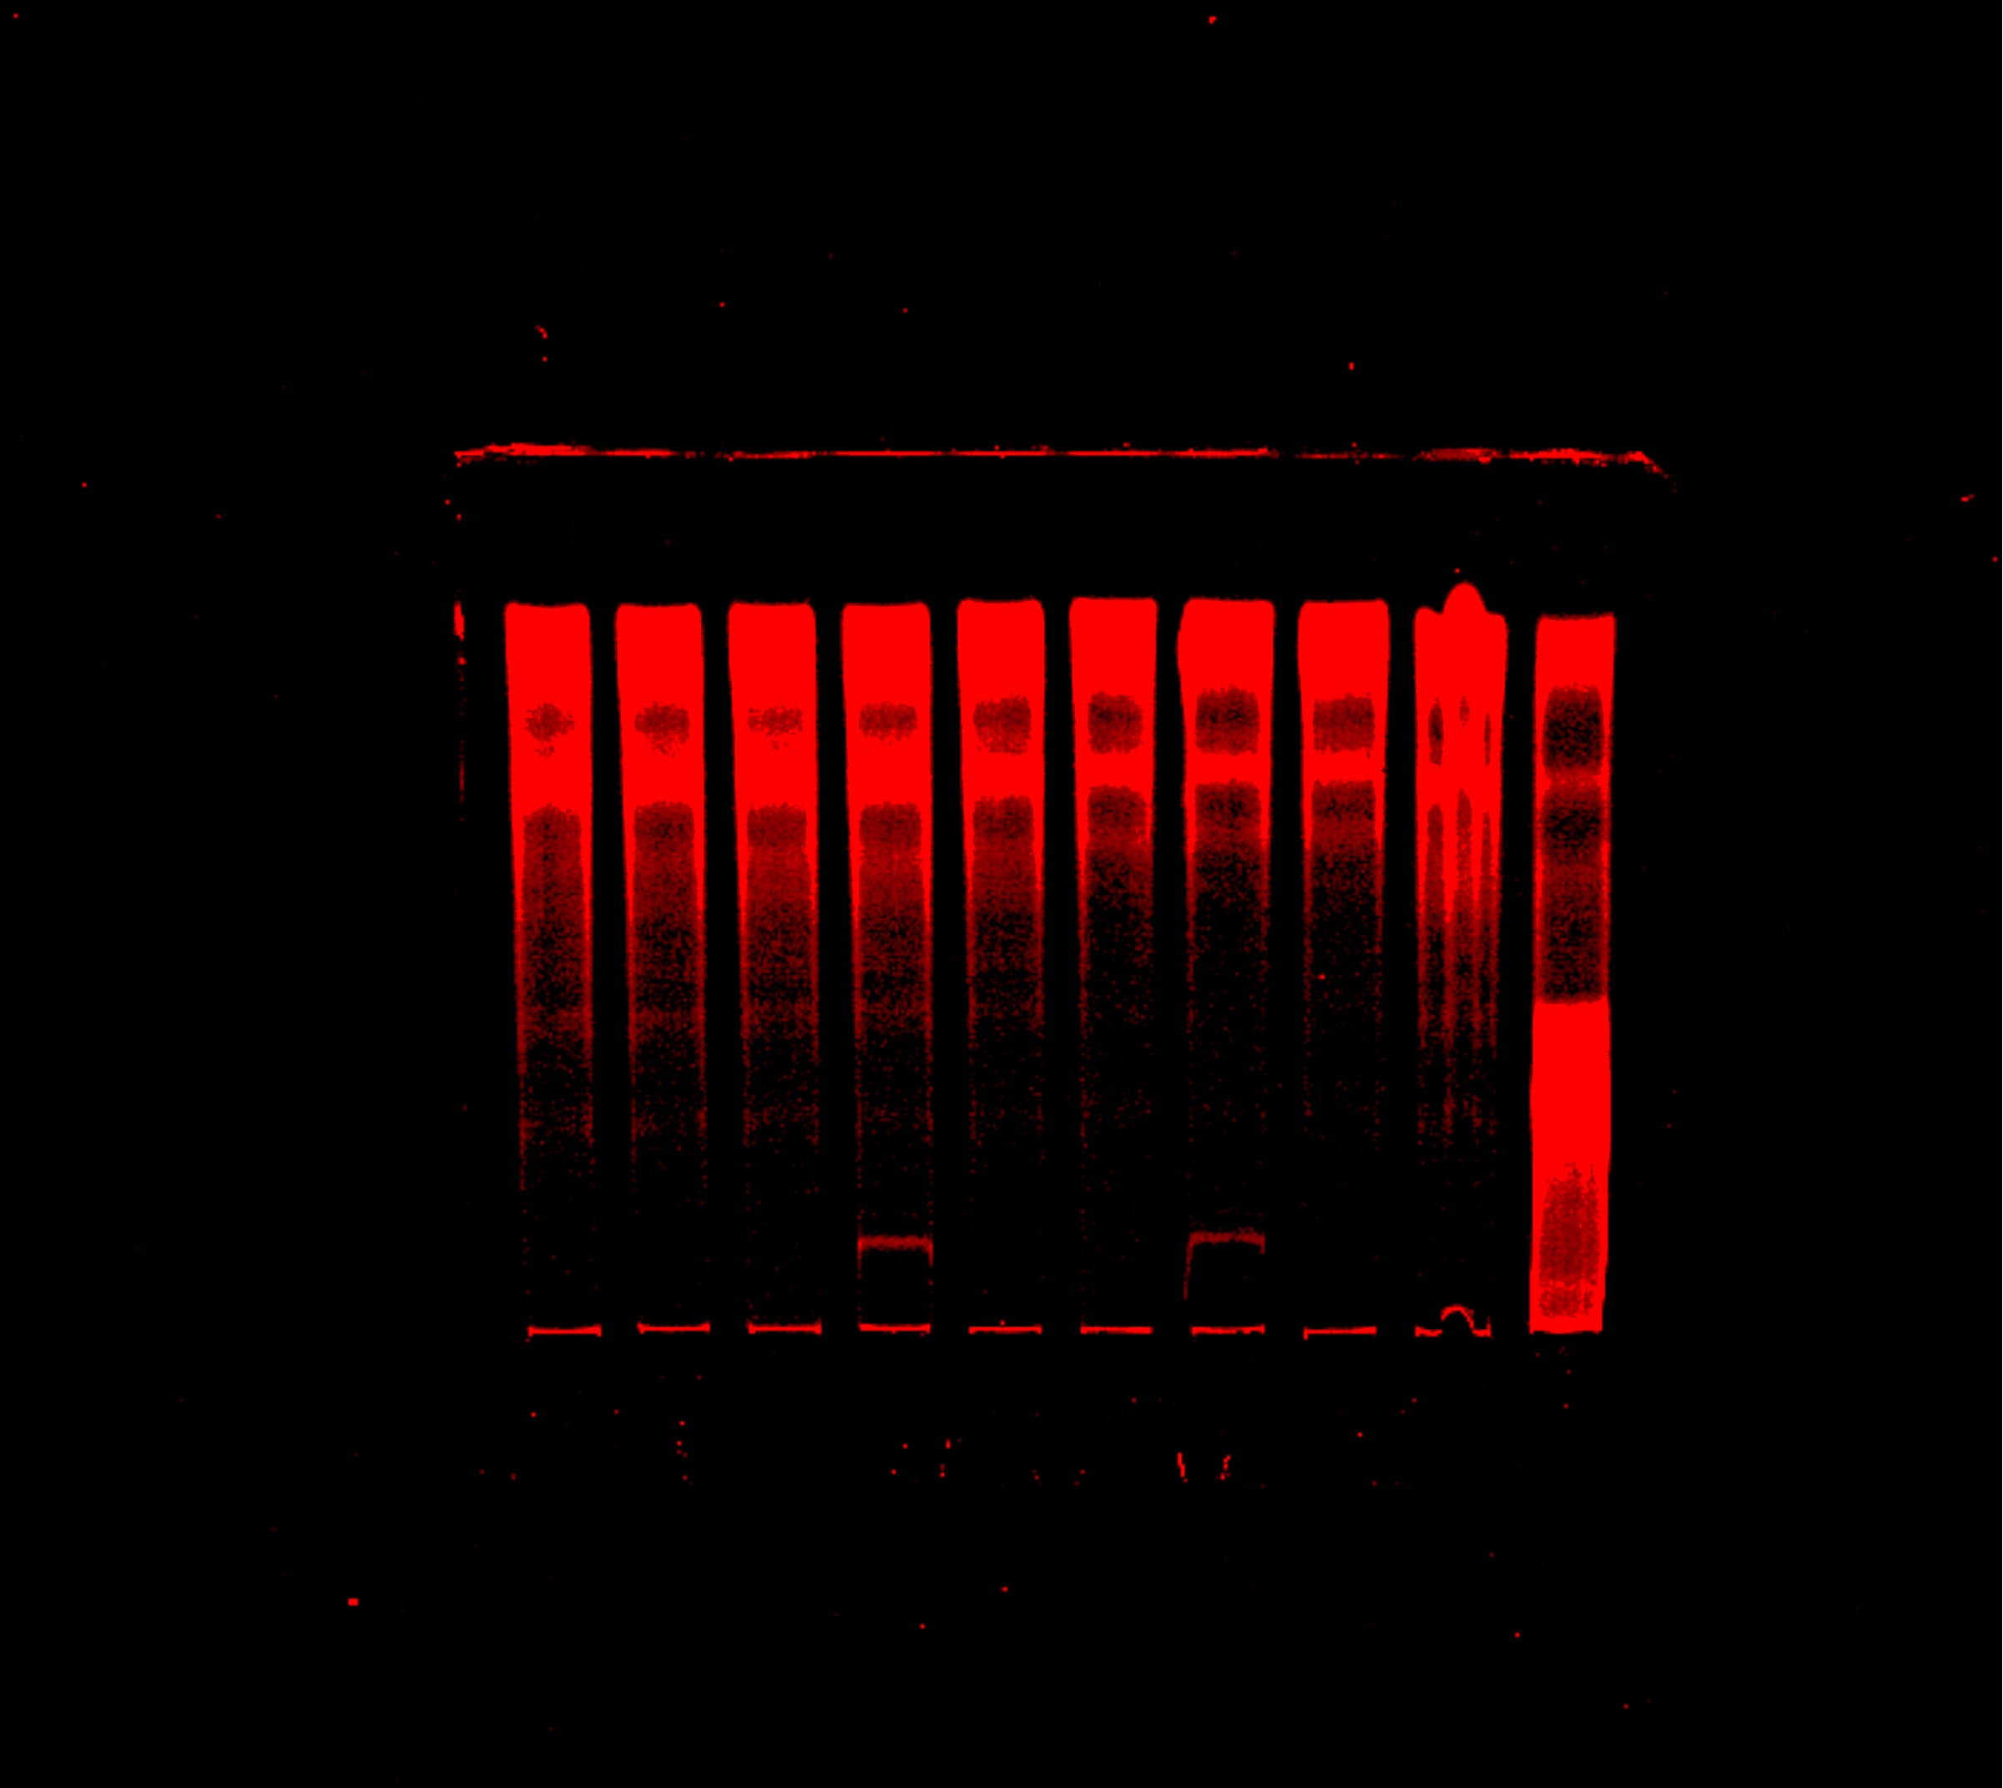
PHE1/AGL40 and HDG3 alone bind to PHE1 targets
proAT2G29140
-1210
-1200
-1188
-1143
-1134
HDG motif
WT
MADS motif
PHE1 31.9Kd
AGL40 28.47Kd
HDG3 80kd
HDG8 78kd
45bp
90bp
90bp
PHE1
1 | - | 1 | - | - | - | 1 | 1 | 1 | -
- | 1 | 1 | - | - | - | 1 | 1 | 1 | -
- | - | - | 1 | - | 1 | 1 | - | 1 | -
- | - | - | - | 1 | 1 | - | 1 | 1 | -
- | - | - | - | - | - | - | - | - | 1
PHE1
- | - | - | - | - | - | - | - | - | 1
- | - | - | - | - | - | - | - | - | 1
1 | - | 1 | 2 | - | 2 | 4 | - | - | -
- | 1 | 1 | - | 2 | 2 | - | 4 | - | -
- | - | - | - | - | - | - | - | 1 | -
AGL40
AGL40
HDG3
HDG3
HDG8
HDG8
TNT-Flag
TNT-Flag
Protein-DNA
Complexes
Protein-DNA
Complexes
Free probes
Free probes
Lanes
1
2
3
4
5
6
7
8
9
10
Lanes
1
2
3
4
5
6
7
8
9
10

Slide 8
HDG3 and PHE1/AGL28 respectively bind to PHE1 targets
proAT2G29140
189bp
-1200
-1188
-1143
-1134
HDG motif
MADS motif
45bp
Note: HDG3 protein was generated independently from PHE1+AGL28
There was no supershift, so no HDG3-PHE1; HDG3-AGL28; HDG3-PHE1/AGL28 complex binding DNA formed in vitro.
EMSA assay with collabration from Peilin
Notes:
indicates the HDG3 block PHE1/AGL28 protein, not only occupied the position of the binding sites (too many free probes).

Slide 9
Assembly of the PHE1 protein complexes in PHE1 targets
Act together
Act antagonistically
AGL40
MADS
PHE1
AGL40
MADS
Less than 150bp
PHE1
AGL40
HDG
PHE1
Less than 150bp
HDG8
HDG3
HDG
HDG8
HDG3
MADS
The DNA structural space is enough for 4 proteins
HDG8
Less than 150bp
HDG3
HDG
The DNA structural space is limited for 2 proteins

